Slide 1
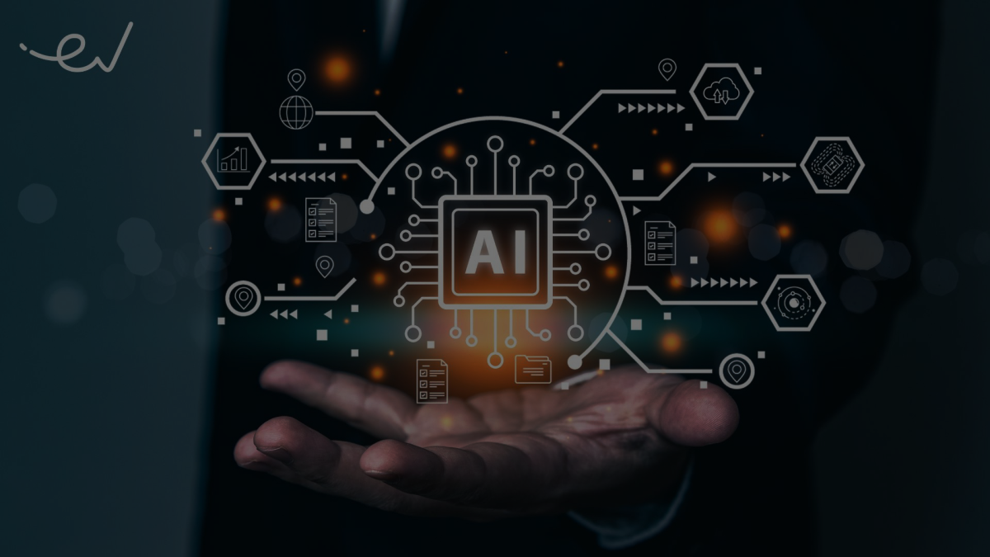
Artificial Intelligence
Rana Badar 24-ST-15

Slide 2
Artificial Intelligence
Rana Badar 24-ST-15

Slide 3


Artificial Intelligence: A Look at the Future
Artificial intelligence (AI) is rapidly changing the world. It's important to understand what AI is and how it works. This presentation will explore the basics of AI, its applications, and potential challenges.

Slide 4

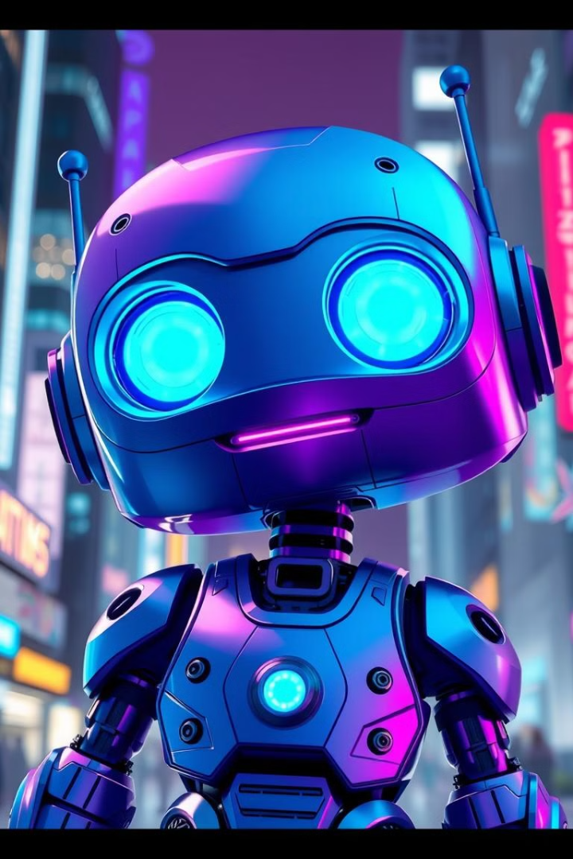
What is Artificial Intelligence?
Definition
Learning
AI is the ability of a machine to mimic intelligent human behavior.
AI systems can learn from data and improve their performance over time.

Slide 5
AI vs. Robots
AI
Robots
Programmed to think and learn.
Programmed to perform tasks.
Capable of social interaction.
Limited interaction capabilities.

Slide 6

Testing Artificial Intelligence
1
Turing Test
2
Imitation Game
Developed by Alan Turing.
Compares AI performance to human performance.

Slide 7
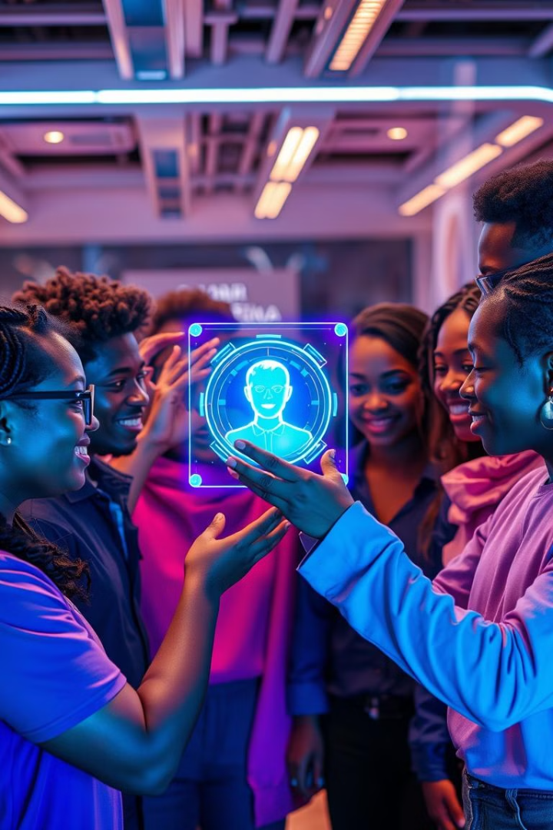




Examples of Artificial Intelligence
CleverBot
Autonomous Cars
A conversational AI that can hold conversations with humans.
Vehicles that can drive themselves using AI.
Drones
Watson
Unmanned aerial vehicles that can be controlled by AI.
An AI system that can answer questions and provide insights.

Slide 8





Challenges of Artificial Intelligence
1
Job Takeover
2
Laziness
3
Cost
4
Priority
5
Relationships

Slide 9
Why AI Matters
1
Ubiquitous Future
2
Understanding AI
3
Daily Interactions
4
Artemis Insights

Slide 10

Thank You!
AI is a powerful tool that can be used for good or bad. It's important to be aware of its potential and to use it responsibly.

